Slide 1

TECH 1004 & TECH 1004 UAC AI Technologies
Computer Vision Intro
By Hu Wang

Slide 2
What is CV

Slide 3

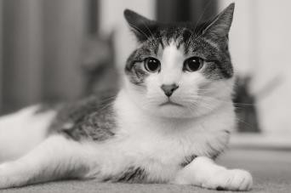

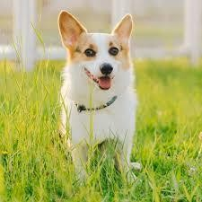
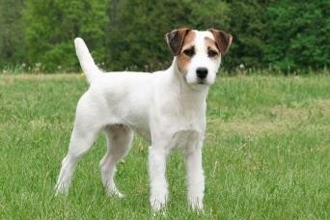
Supervised Learning
“Cat”
𝑦
𝒇
𝑥
𝑥₁:
𝑦₁:“Cat”
𝑥₂:
𝑦₂:“Cat”
𝑥₃:
𝑦₃:“Dog”
𝑥₄:
𝑦₄:“Dog”
Labelled Data

Slide 4

Digital images

Slide 5
History of CV

Slide 6
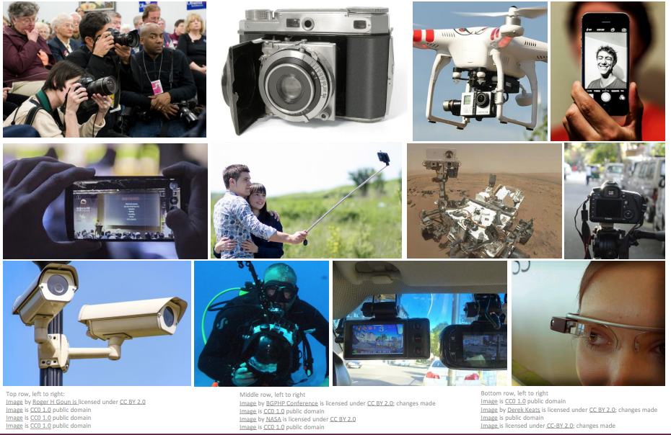
Data --- images
cs231n_2019_lecture01.pdf

Slide 7
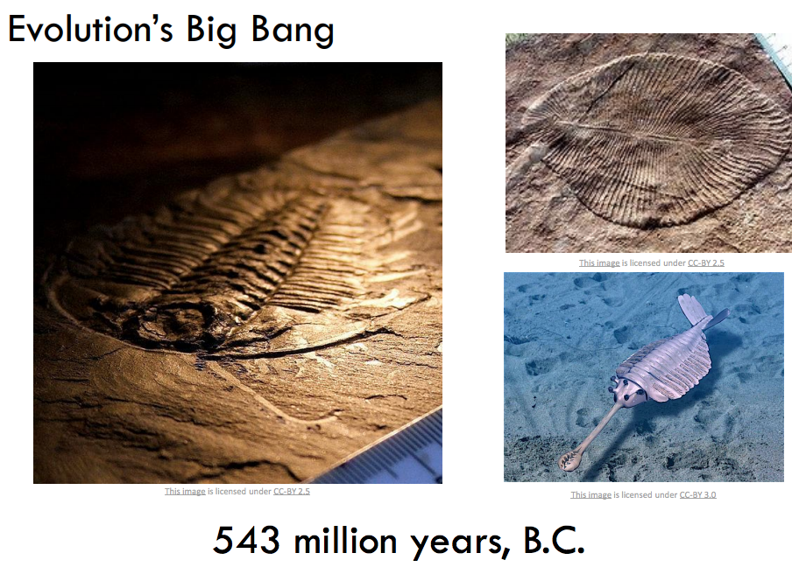
Emerging of Computer Vision
cs231n_2019_lecture01.pdf

Slide 8
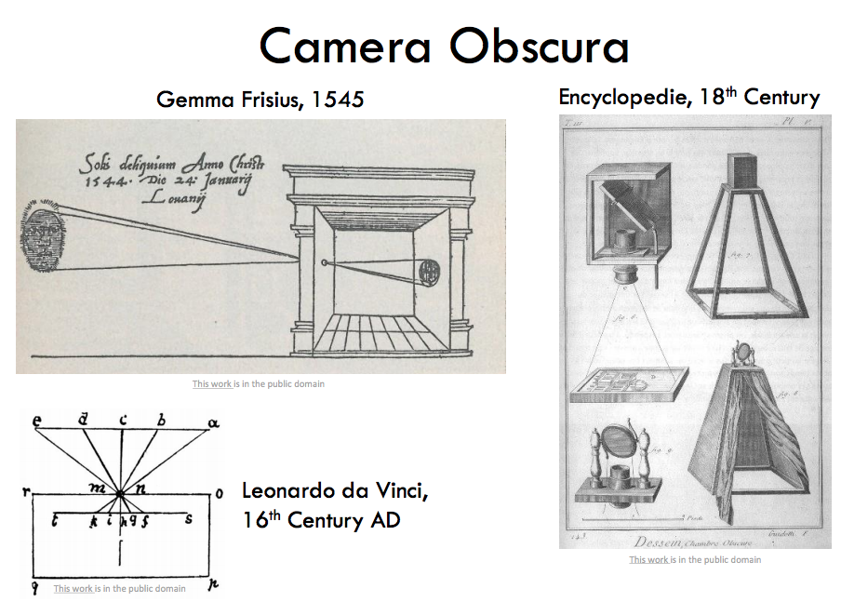
Emerging of Computer Vision
cs231n_2019_lecture01.pdf

Slide 9
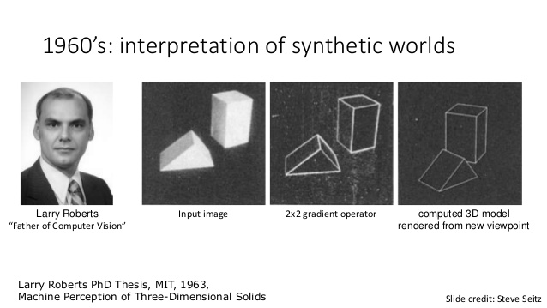
Block World

Slide 10

Emerging of Computer Vision
cs231n_2019_lecture01.pdf

Slide 11
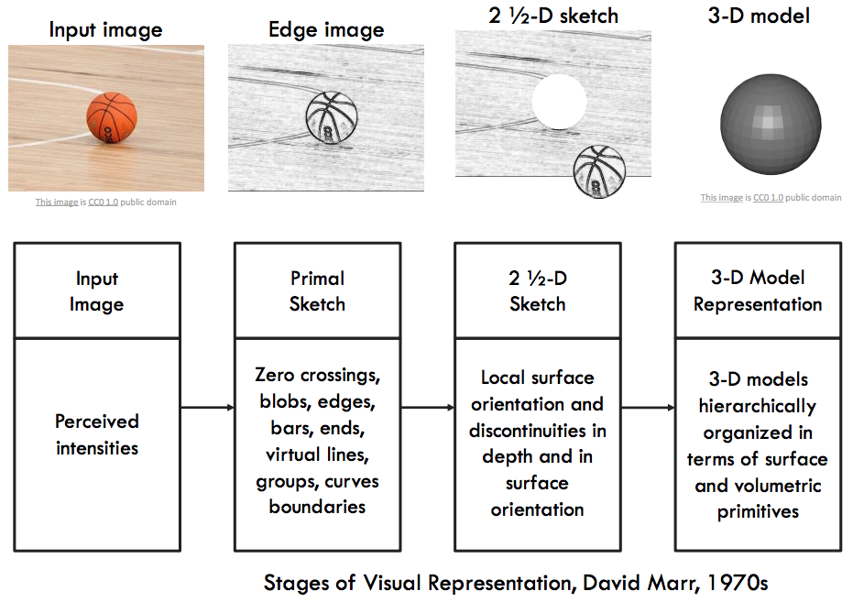
Emerging of Computer Vision
cs231n_2019_lecture01.pdf

Slide 12
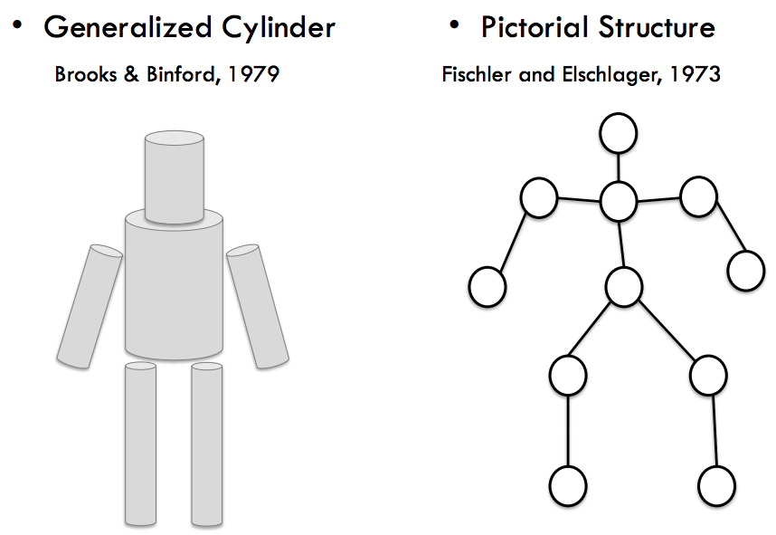
Emerging of Computer Vision
cs231n_2019_lecture01.pdf

Slide 13
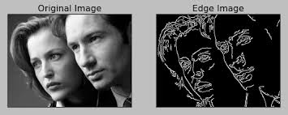
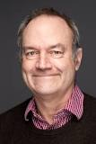
Canny Edge Detector
By John F. Canny in 1986

Slide 14
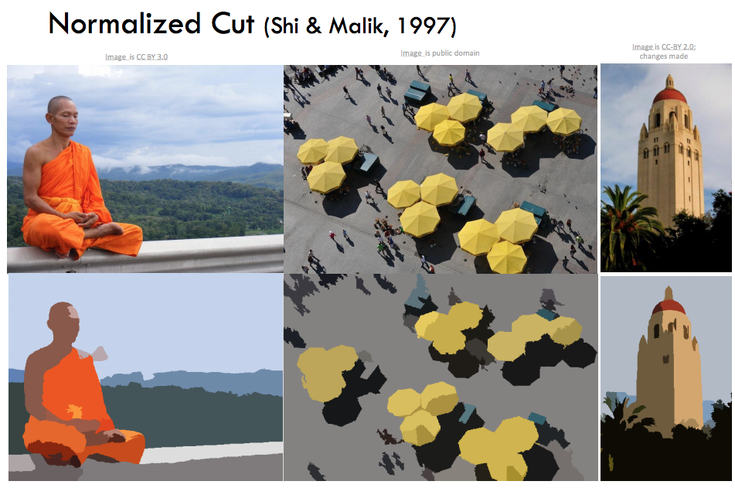
History of Computer Vision
cs231n_2019_lecture01.pdf

Slide 15
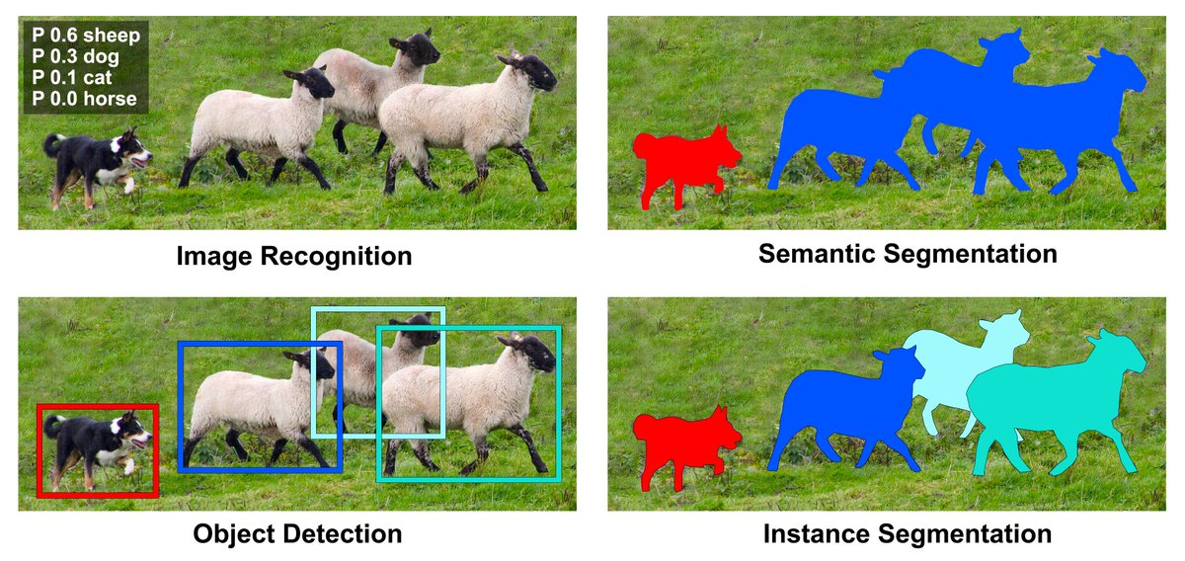
Computer Vision tasks

Slide 16
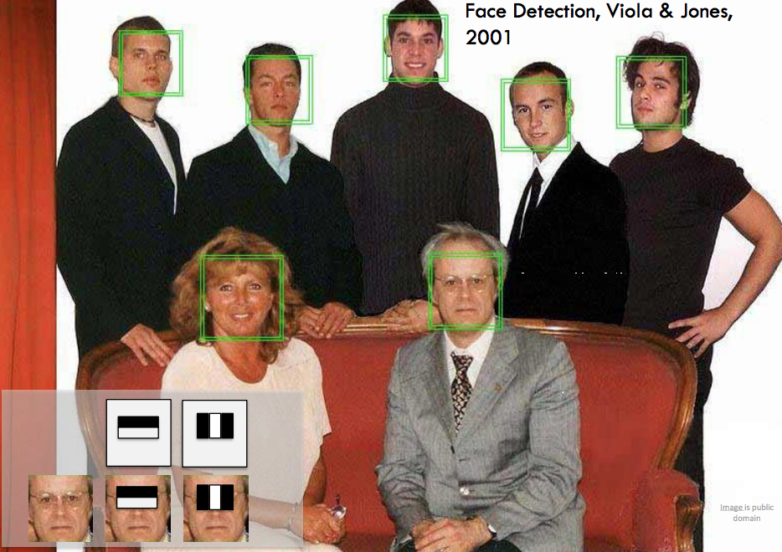
History of Computer Vision
cs231n_2019_lecture01.pdf

Slide 17
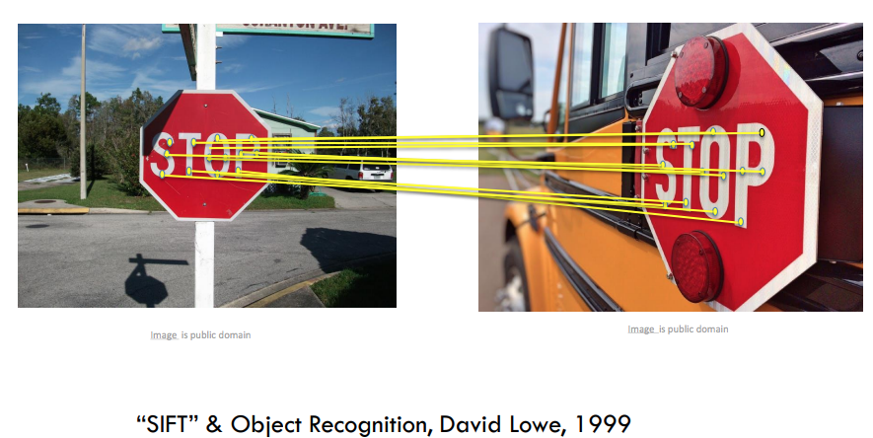
History of Computer Vision
cs231n_2019_lecture01.pdf

Slide 18
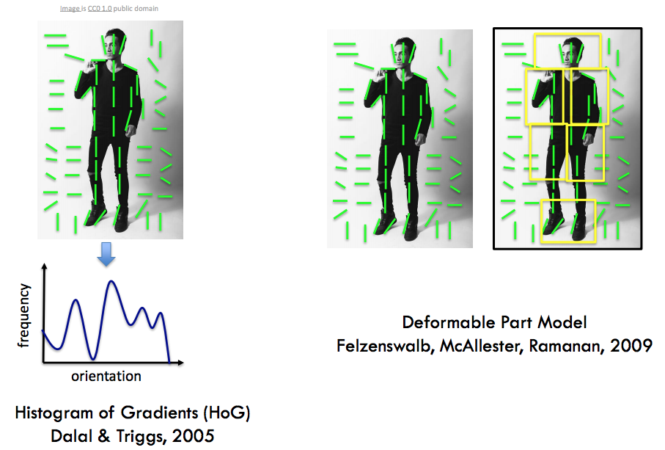
History of Computer Vision
cs231n_2019_lecture01.pdf

Slide 19

History of Computer Vision
https://pjreddie.com/darknet/yolo/

Slide 20
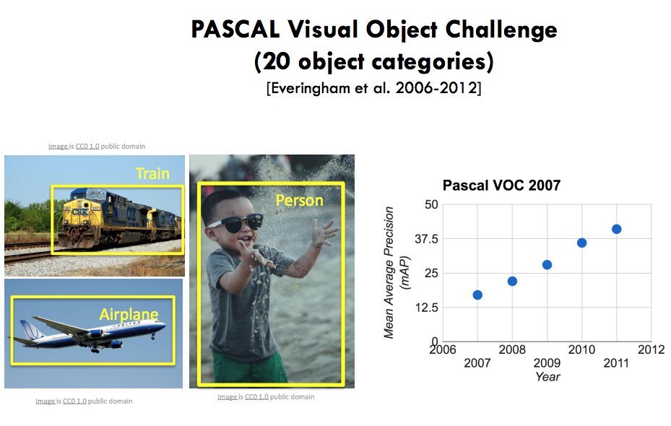
History of Computer Vision
cs231n_2019_lecture01.pdf

Slide 21
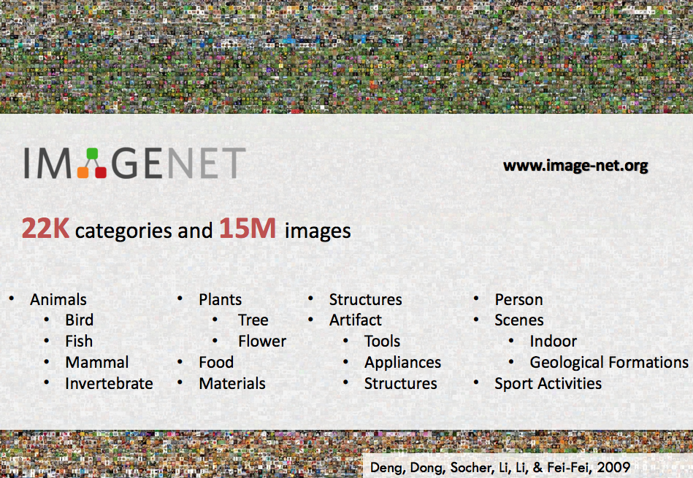
History of Computer Vision
cs231n_2019_lecture01.pdf

Slide 22
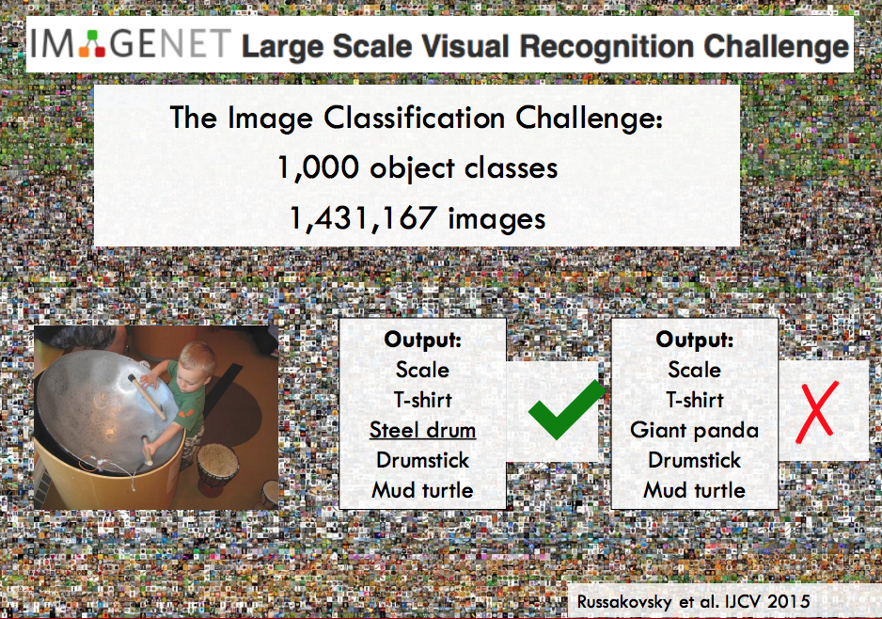
History of Computer Vision
cs231n_2019_lecture01.pdf

Slide 23
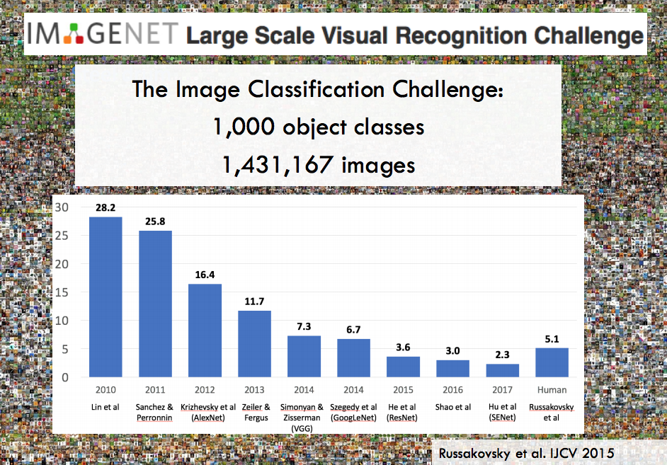
History of Computer Vision
cs231n_2019_lecture01.pdf

Slide 24
CV Tasks

Slide 25
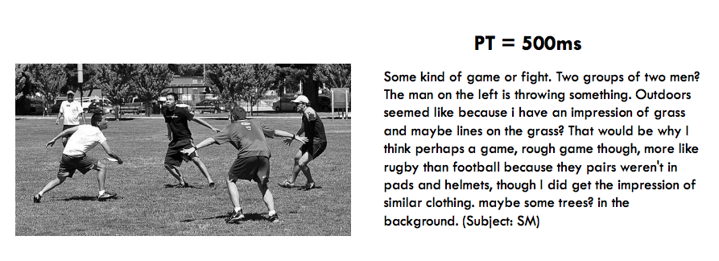
Computer Vision tasks
cs231n_2019_lecture01.pdf

Slide 26
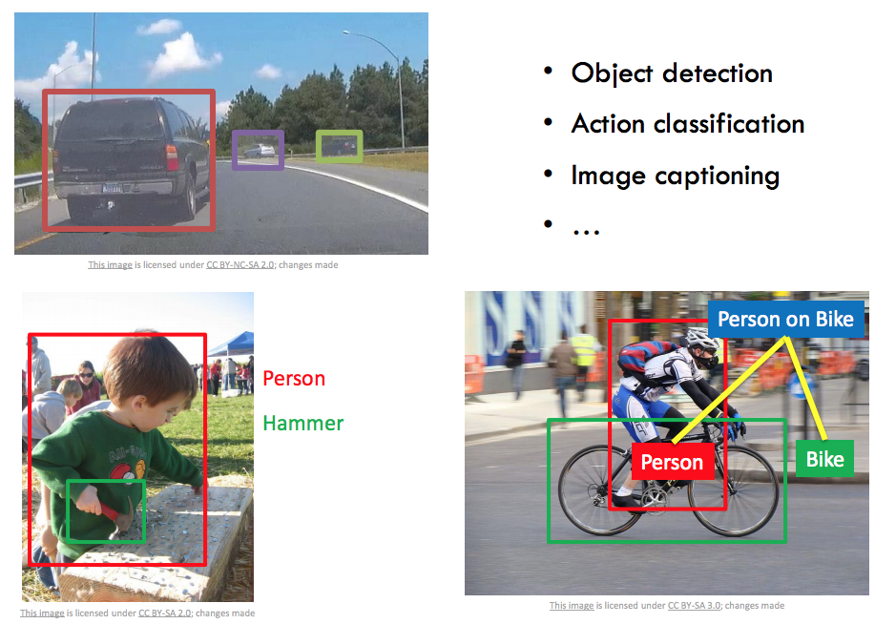
Computer Vision tasks
cs231n_2019_lecture01.pdf

Slide 27
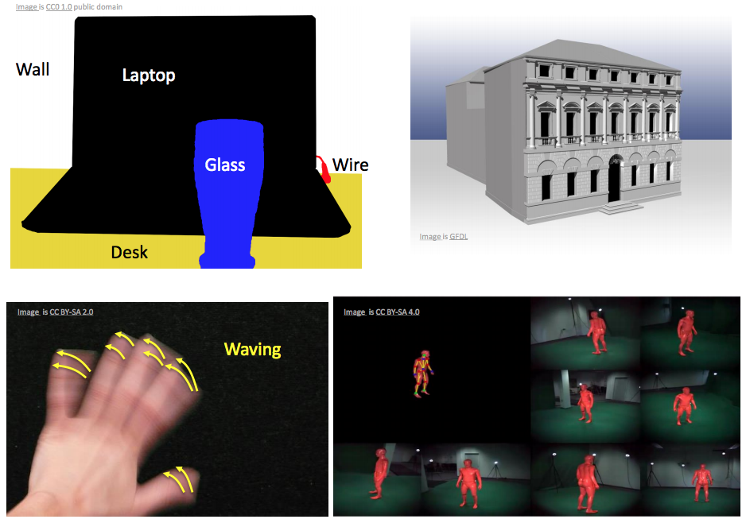
Computer Vision tasks
cs231n_2019_lecture01.pdf

Slide 28
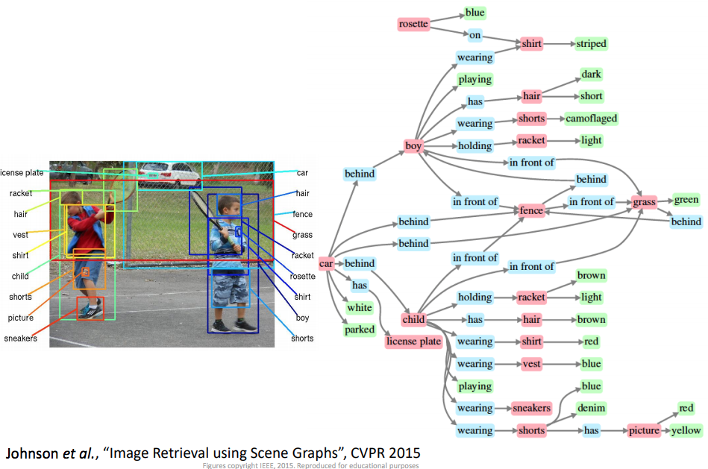
Computer Vision tasks
cs231n_2019_lecture01.pdf

Slide 29
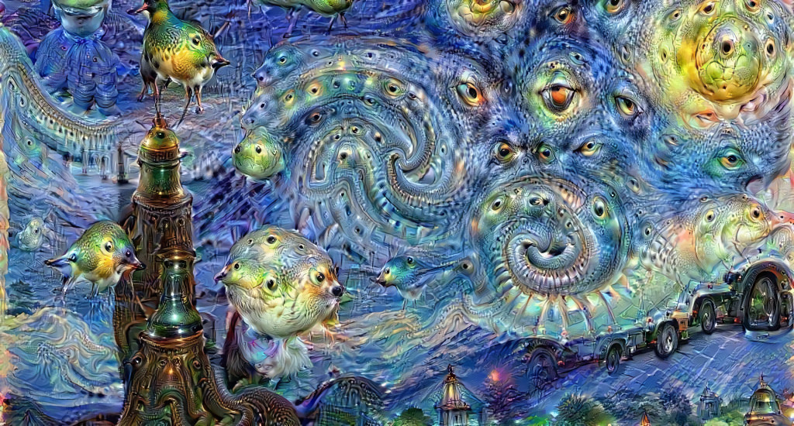
Deep Dream

Slide 30
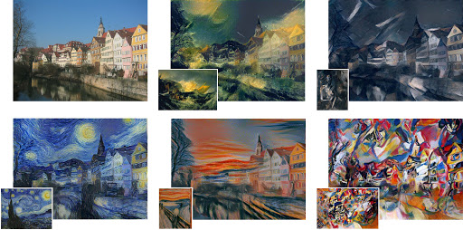
Style Transfer

Slide 31
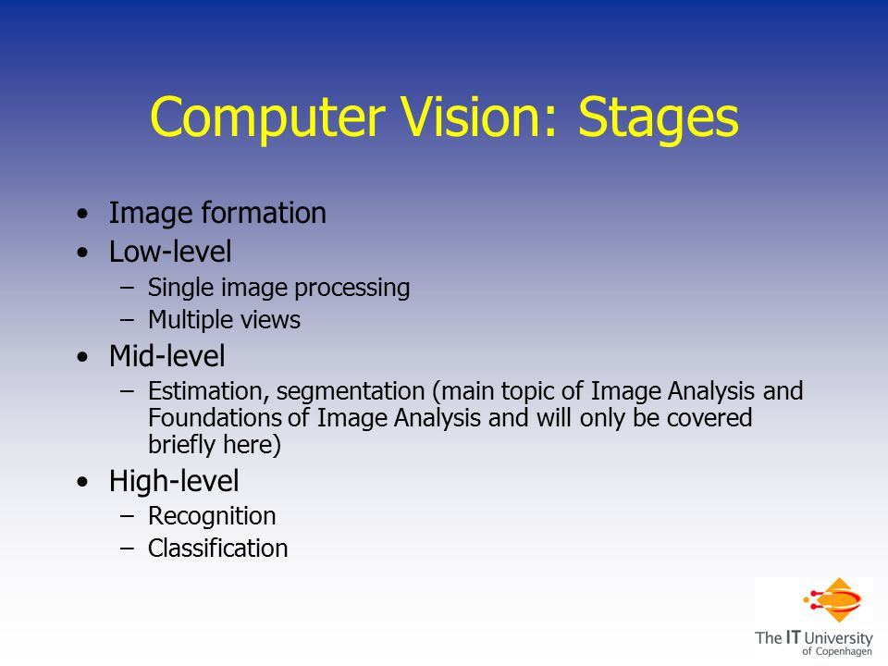
Three Categories of Tasks in CV
https://slideplayer.com/slide/5146536/

Slide 32
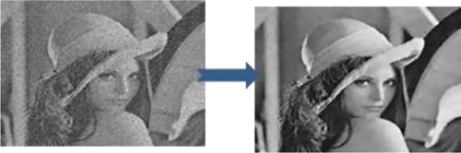
Low level CV --- Denoising

Slide 33
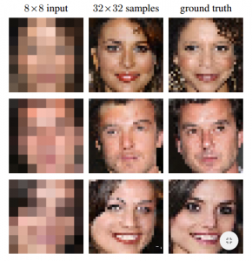
Low level CV --- Super-Resolution

Slide 34

Low level CV --- Dehaze

Slide 35
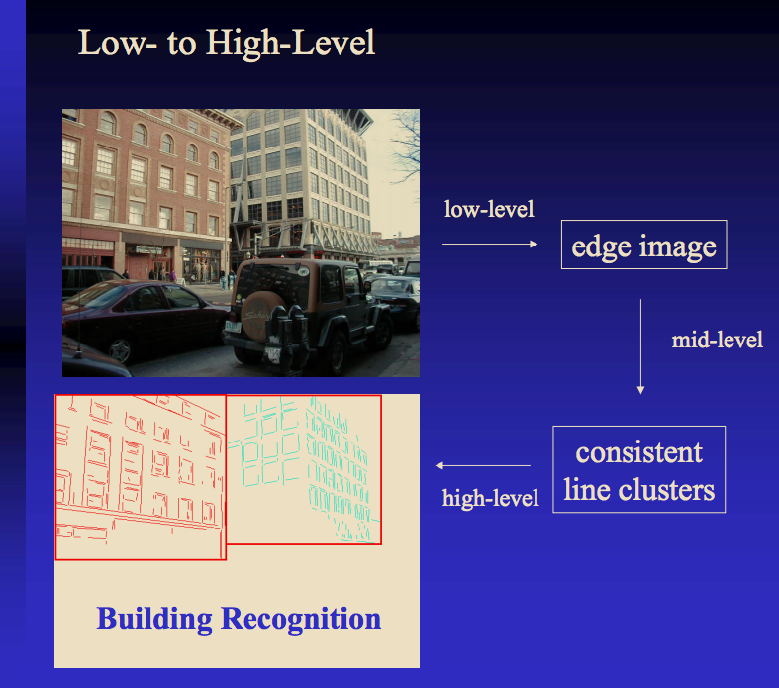
Three Categories of Tasks in CV
https://courses.cs.washington.edu/courses/cse576/06sp/notes/Basics1.pdf

Slide 36
Image Classification with KNN

Slide 37
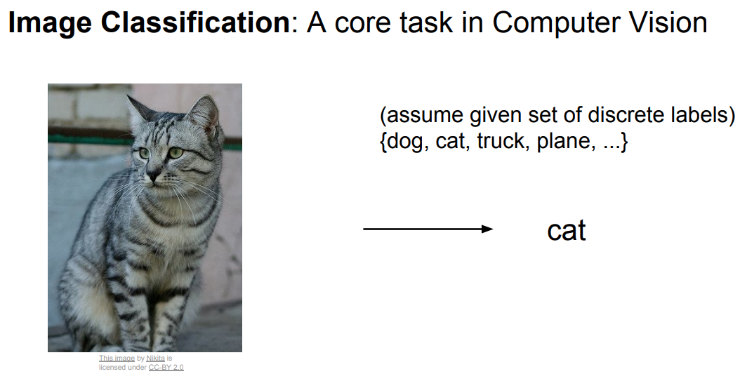
Problems
cs231n_2019_lecture02.pdf

Slide 38
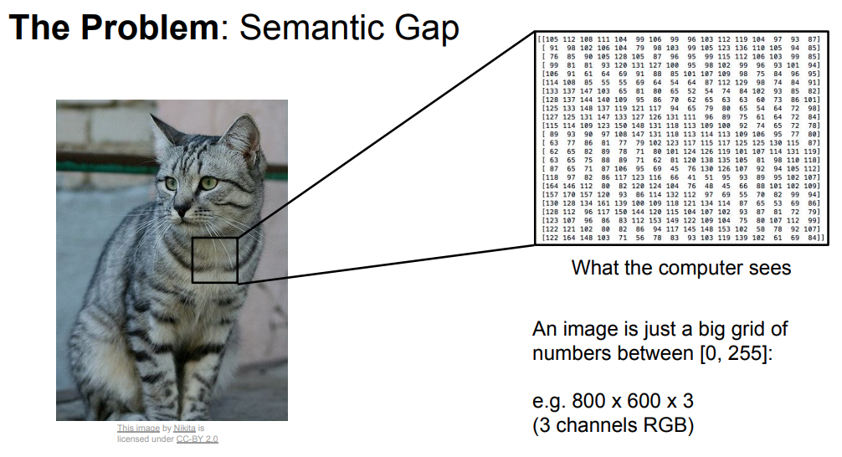
Problems
cs231n_2019_lecture02.pdf

Slide 39
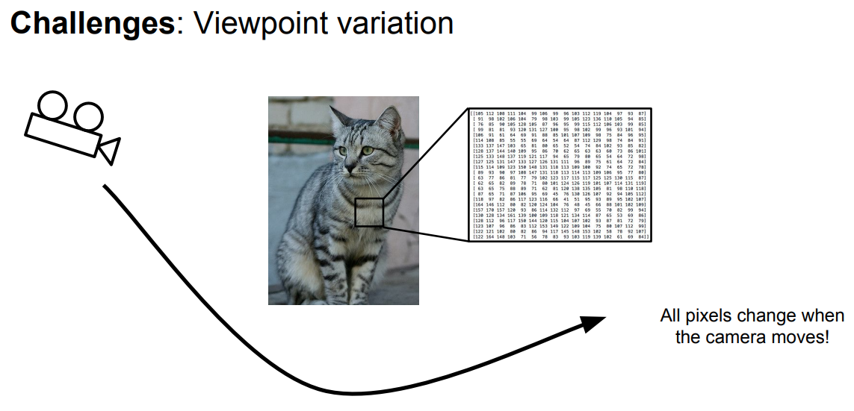
cs231n_2019_lecture02.pdf

Slide 40
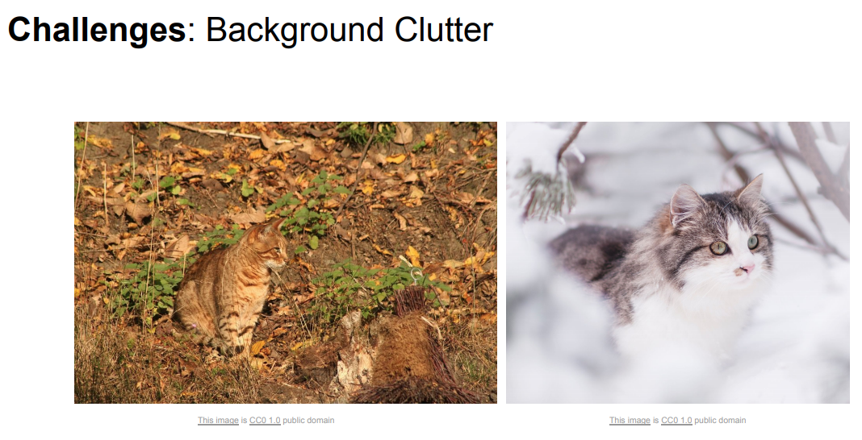
cs231n_2019_lecture02.pdf

Slide 41
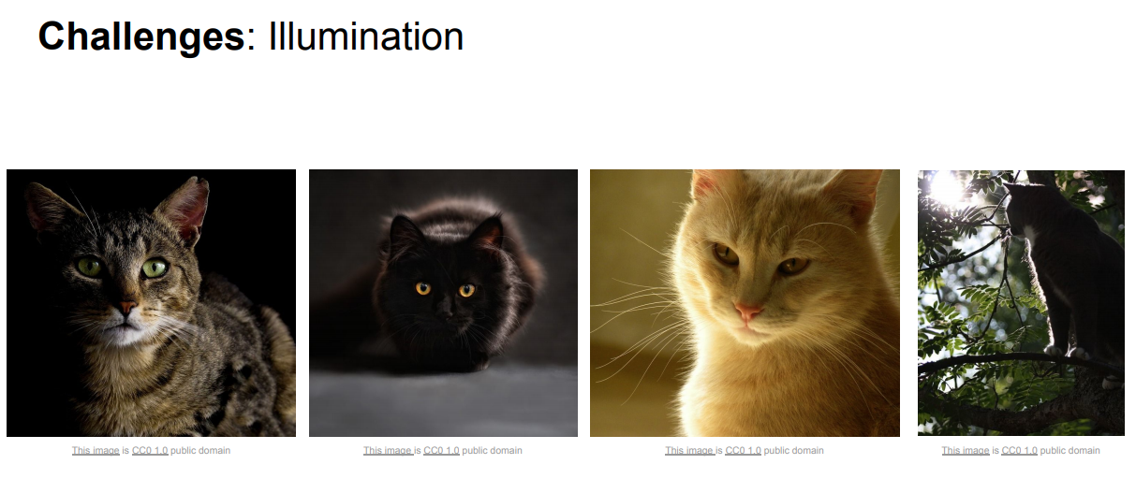
cs231n_2019_lecture02.pdf

Slide 42
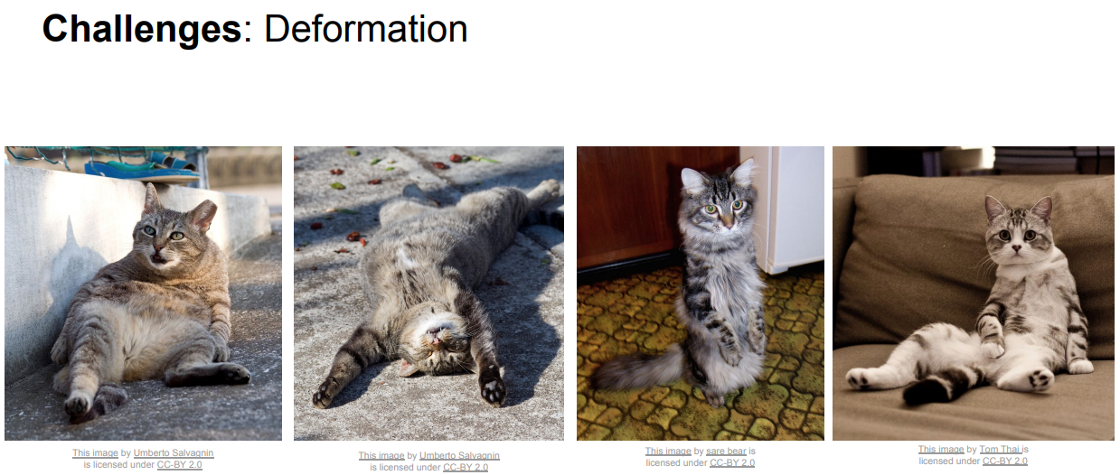
cs231n_2019_lecture02.pdf

Slide 43
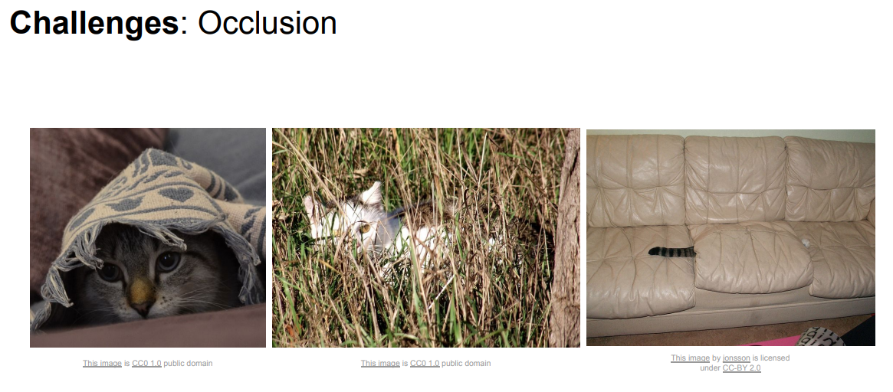
cs231n_2019_lecture02.pdf

Slide 44
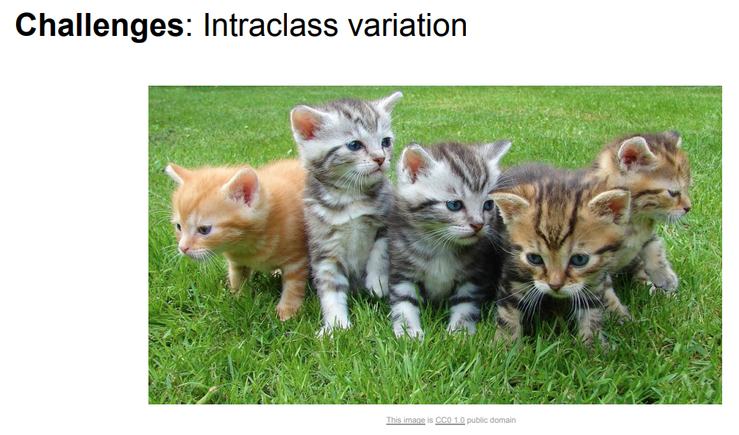
cs231n_2019_lecture02.pdf

Slide 45
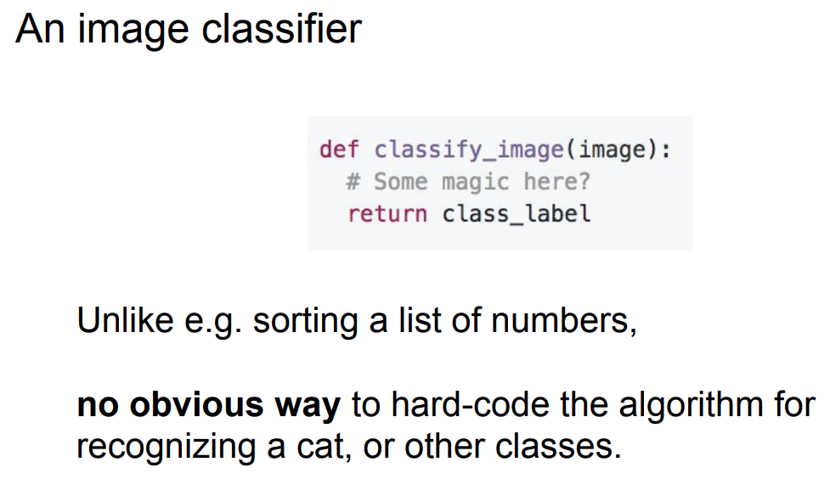
cs231n_2019_lecture02.pdf

Slide 46
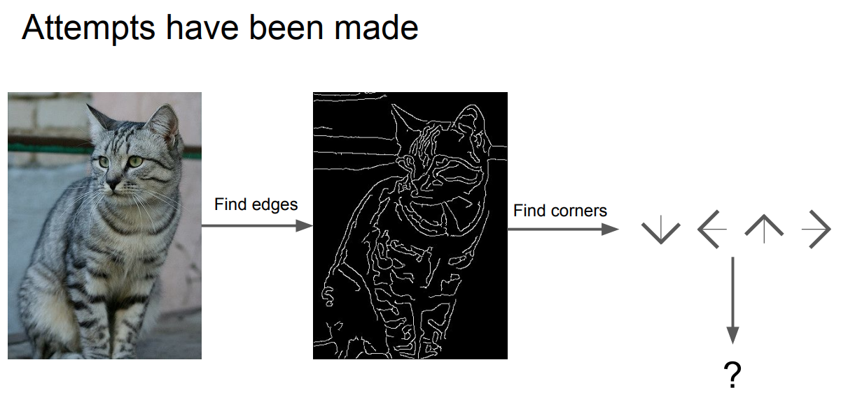
cs231n_2019_lecture02.pdf

Slide 47
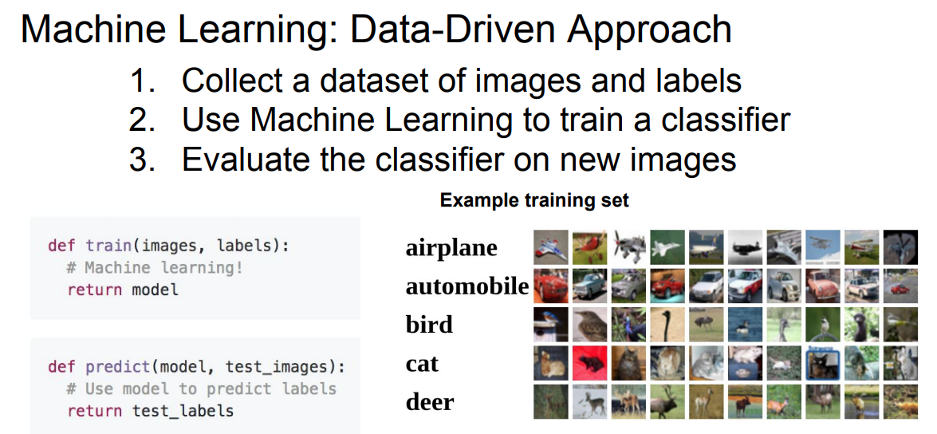
cs231n_2019_lecture02.pdf

Slide 48
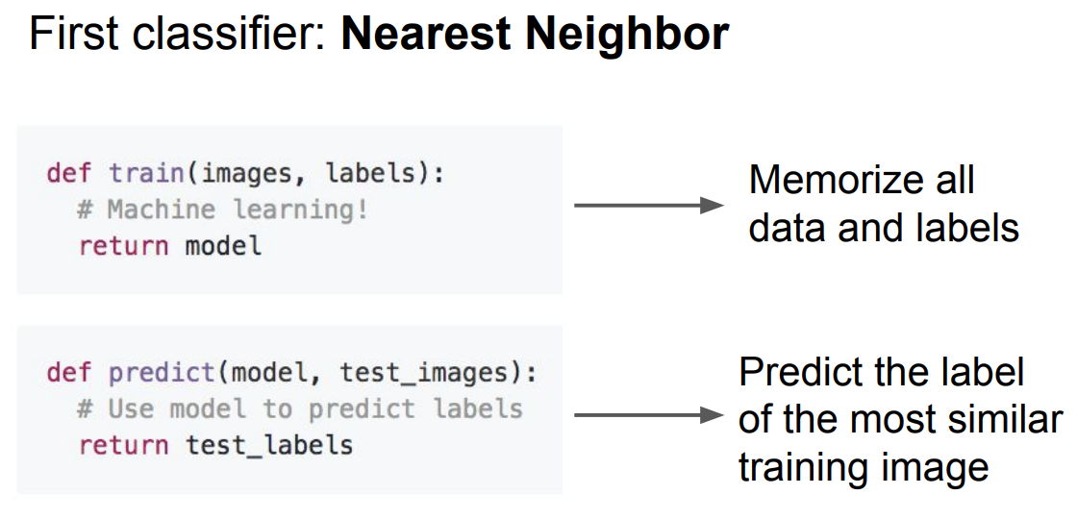
cs231n_2019_lecture02.pdf

Slide 49
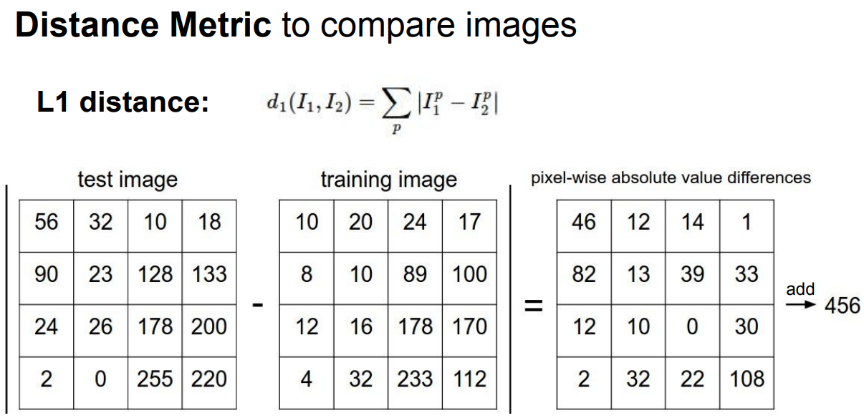
cs231n_2019_lecture02.pdf

Slide 50
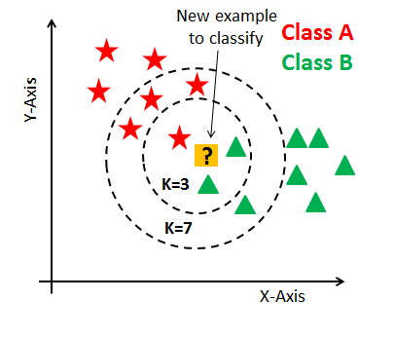
KNN

Slide 51
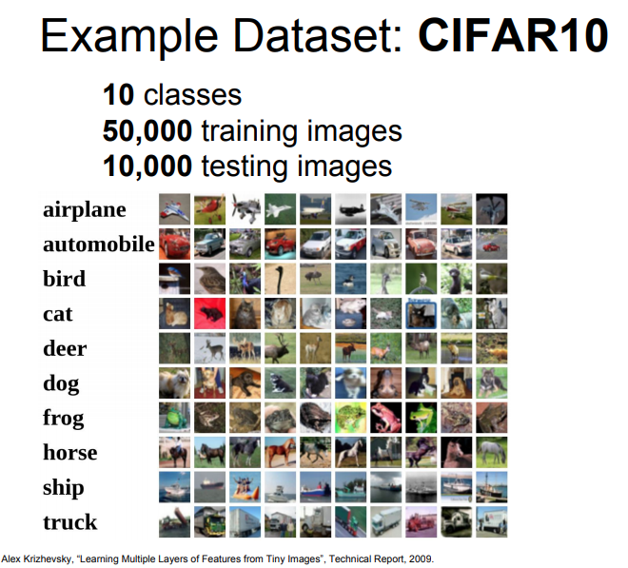
cs231n_2019_lecture02.pdf

Slide 52
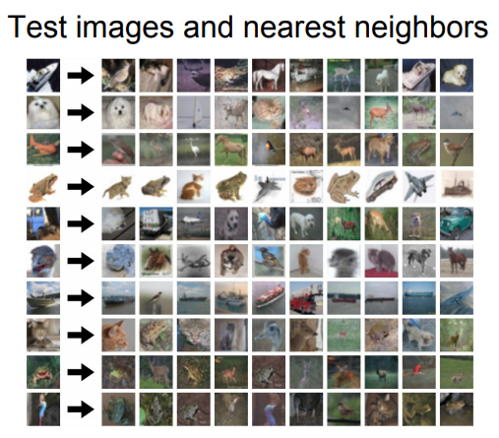
cs231n_2019_lecture02.pdf

Slide 53
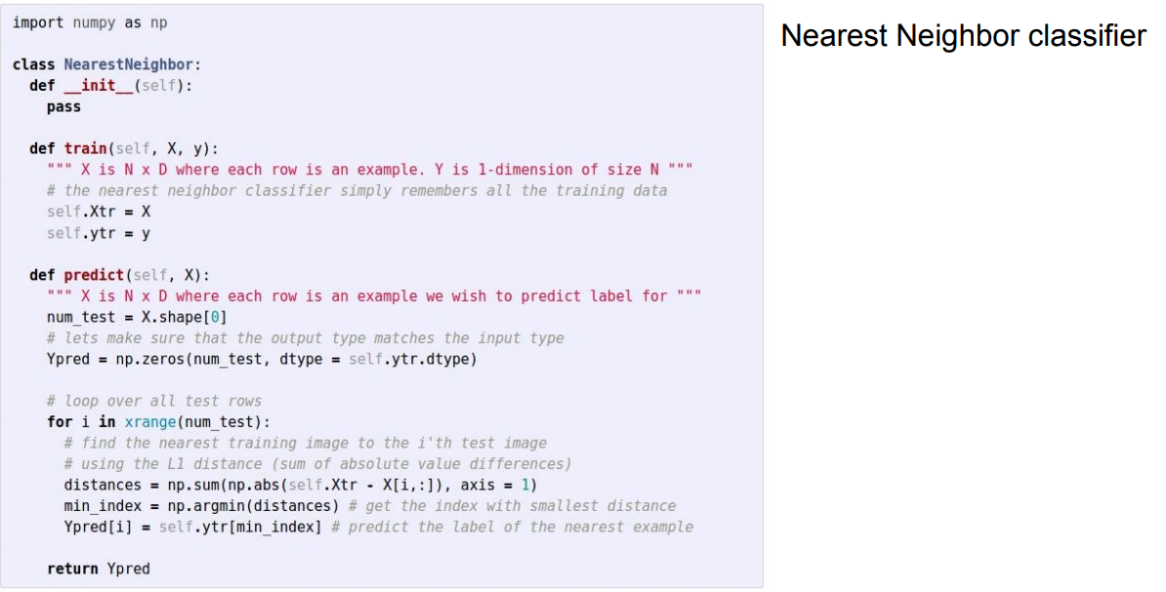
KNN classifier implementation
cs231n_2019_lecture02.pdf

Slide 54
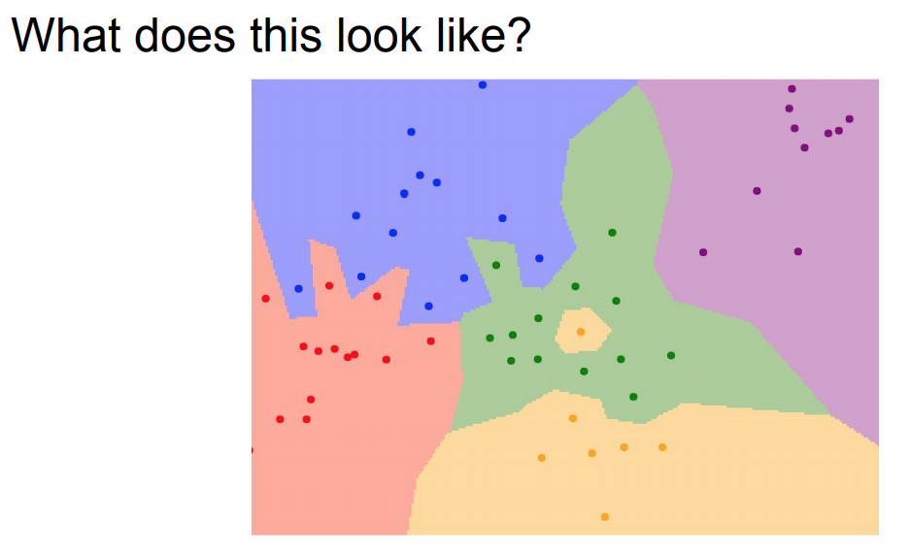
cs231n_2019_lecture02.pdf

Slide 55
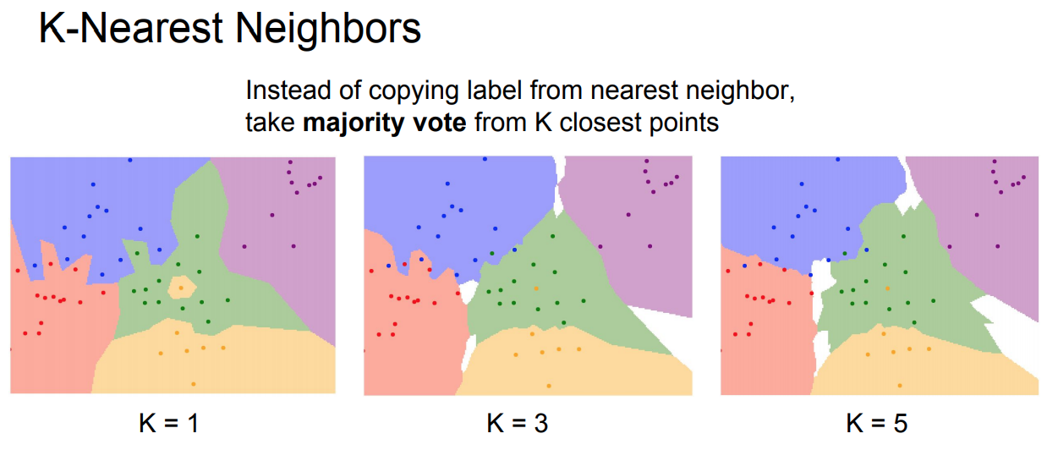
cs231n_2019_lecture02.pdf

Slide 56
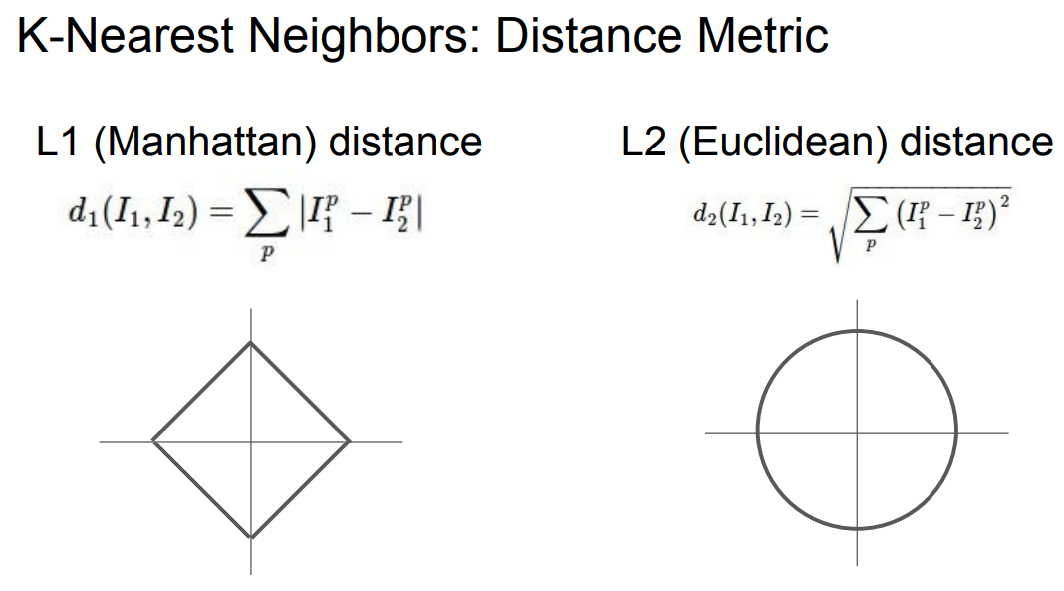
cs231n_2019_lecture02.pdf

Slide 57

http://vision.stanford.edu/teaching/cs231n-demos/knn/
cs231n_2019_lecture02.pdf

Slide 58

cs231n_2019_lecture02.pdf

Slide 59

cs231n_2019_lecture02.pdf

Slide 60

cs231n_2019_lecture02.pdf

Slide 61
Reference
Cs231n Stanford University Tutorial
http://cs231n.stanford.edu/
https://www.youtube.com/watch?v=vT1JzLTH4G4
Canny edge detector
https://en.wikipedia.org/wiki/Canny_edge_detector

